Slide 1
Comparor v3 – AI Workforce Impact in Connecticut

Slide 2
- Over 1,030 CT FTEs are involved in exception-based private claim workflows
- 70% of FTEs are exposed to High or Very High AI Risk by 4–7 years
- Risk is front-loaded into clerical and exception processing subtasks
- 81% of impacted FTEs fall in Low-to-Moderate Skill Burden roles
- Risk concentrated in EZ2–EZ3 and <9-year tenure bands
- AI deployment is driven by both UDP (intake, review) and PEP (prediction, adjudication)
<<EXEC_SUMMARY_PLACEHOLDER>>

Slide 3
<<WORKFLOW_SCOPE_PLACEHOLDER>>
Workflow Name | CT Adjusted FTEs | Avg EZ | Tenure <3 | Tenure 4–9 | Tenure 10+
Private Claims Exceptions | 1031 | EZ 3 | 20.2% | 38.2% | 35.2%

Slide 4
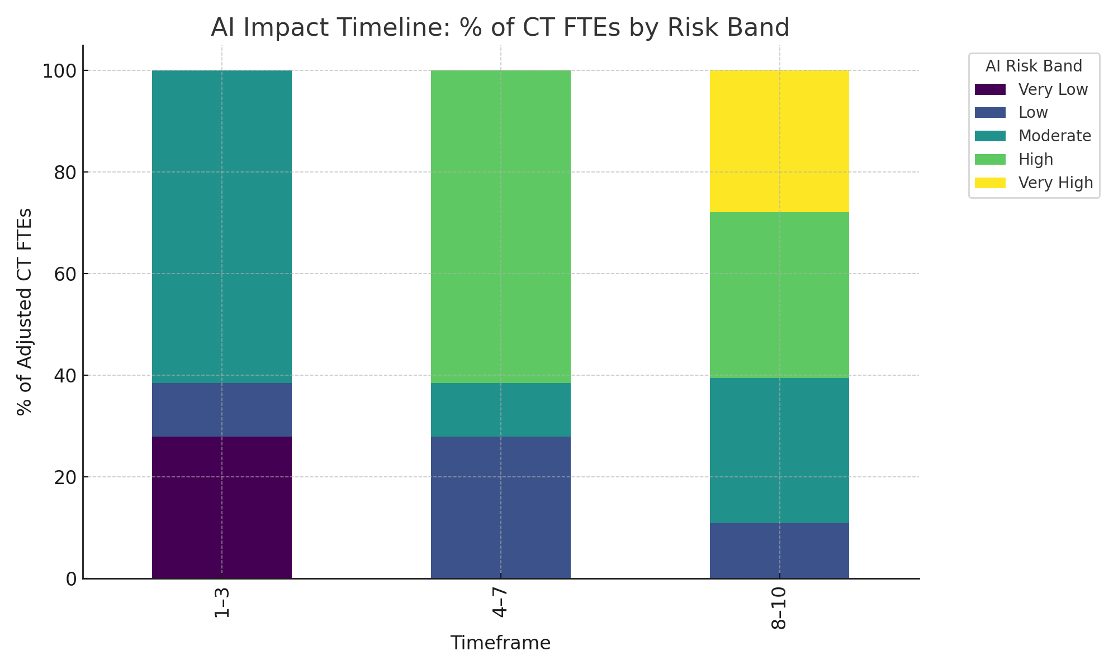
Chart 1 – AI Impact Timeline

Slide 5
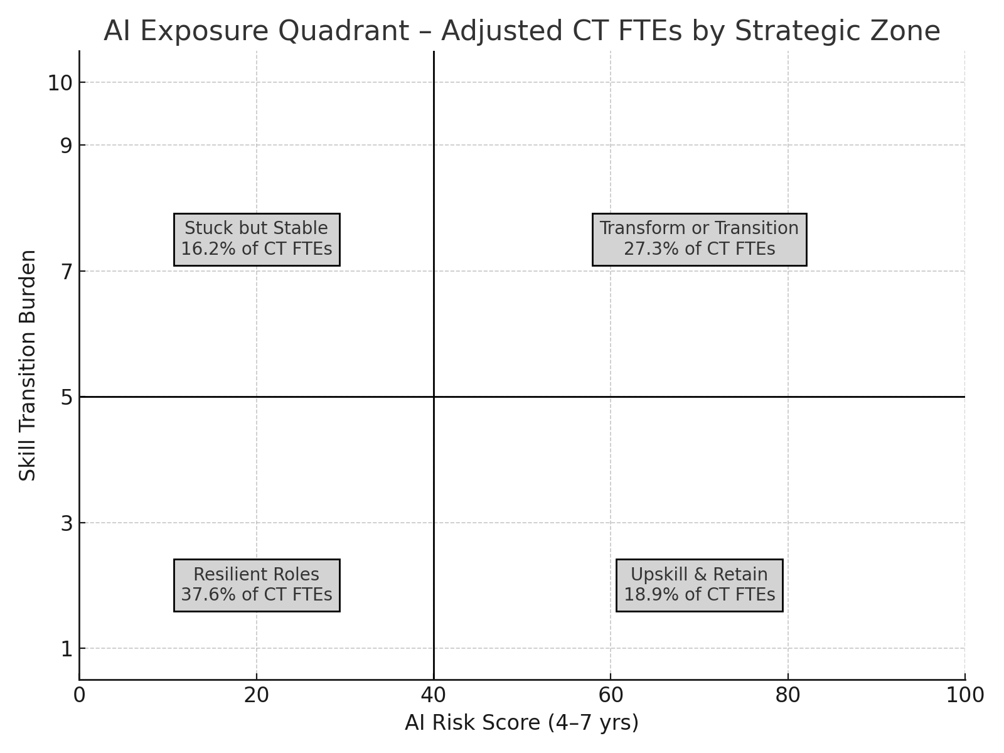
<<QUADRANT_SUMMARY_PLACEHOLDER>>

Slide 6
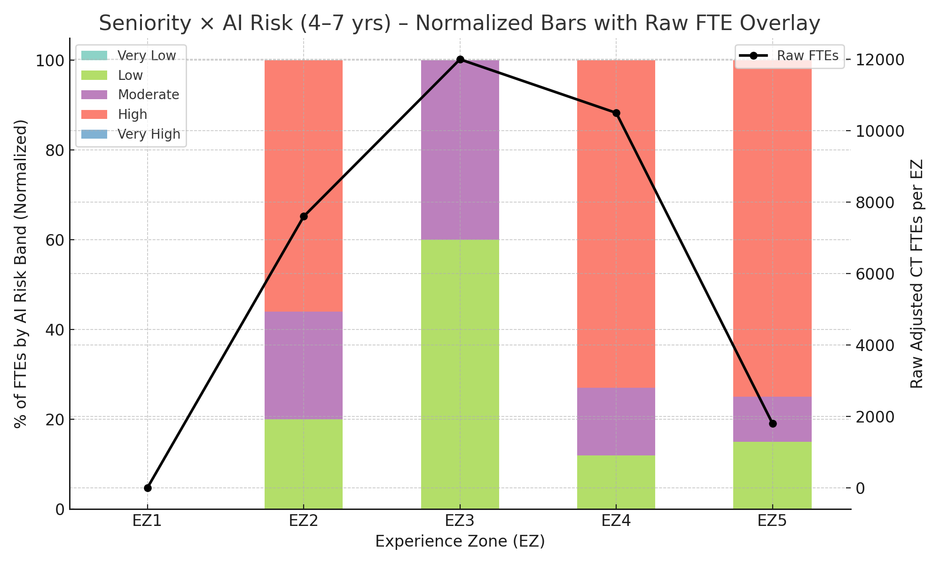
Chart 3 – Seniority × AI Risk (4–7 yrs)

Slide 7
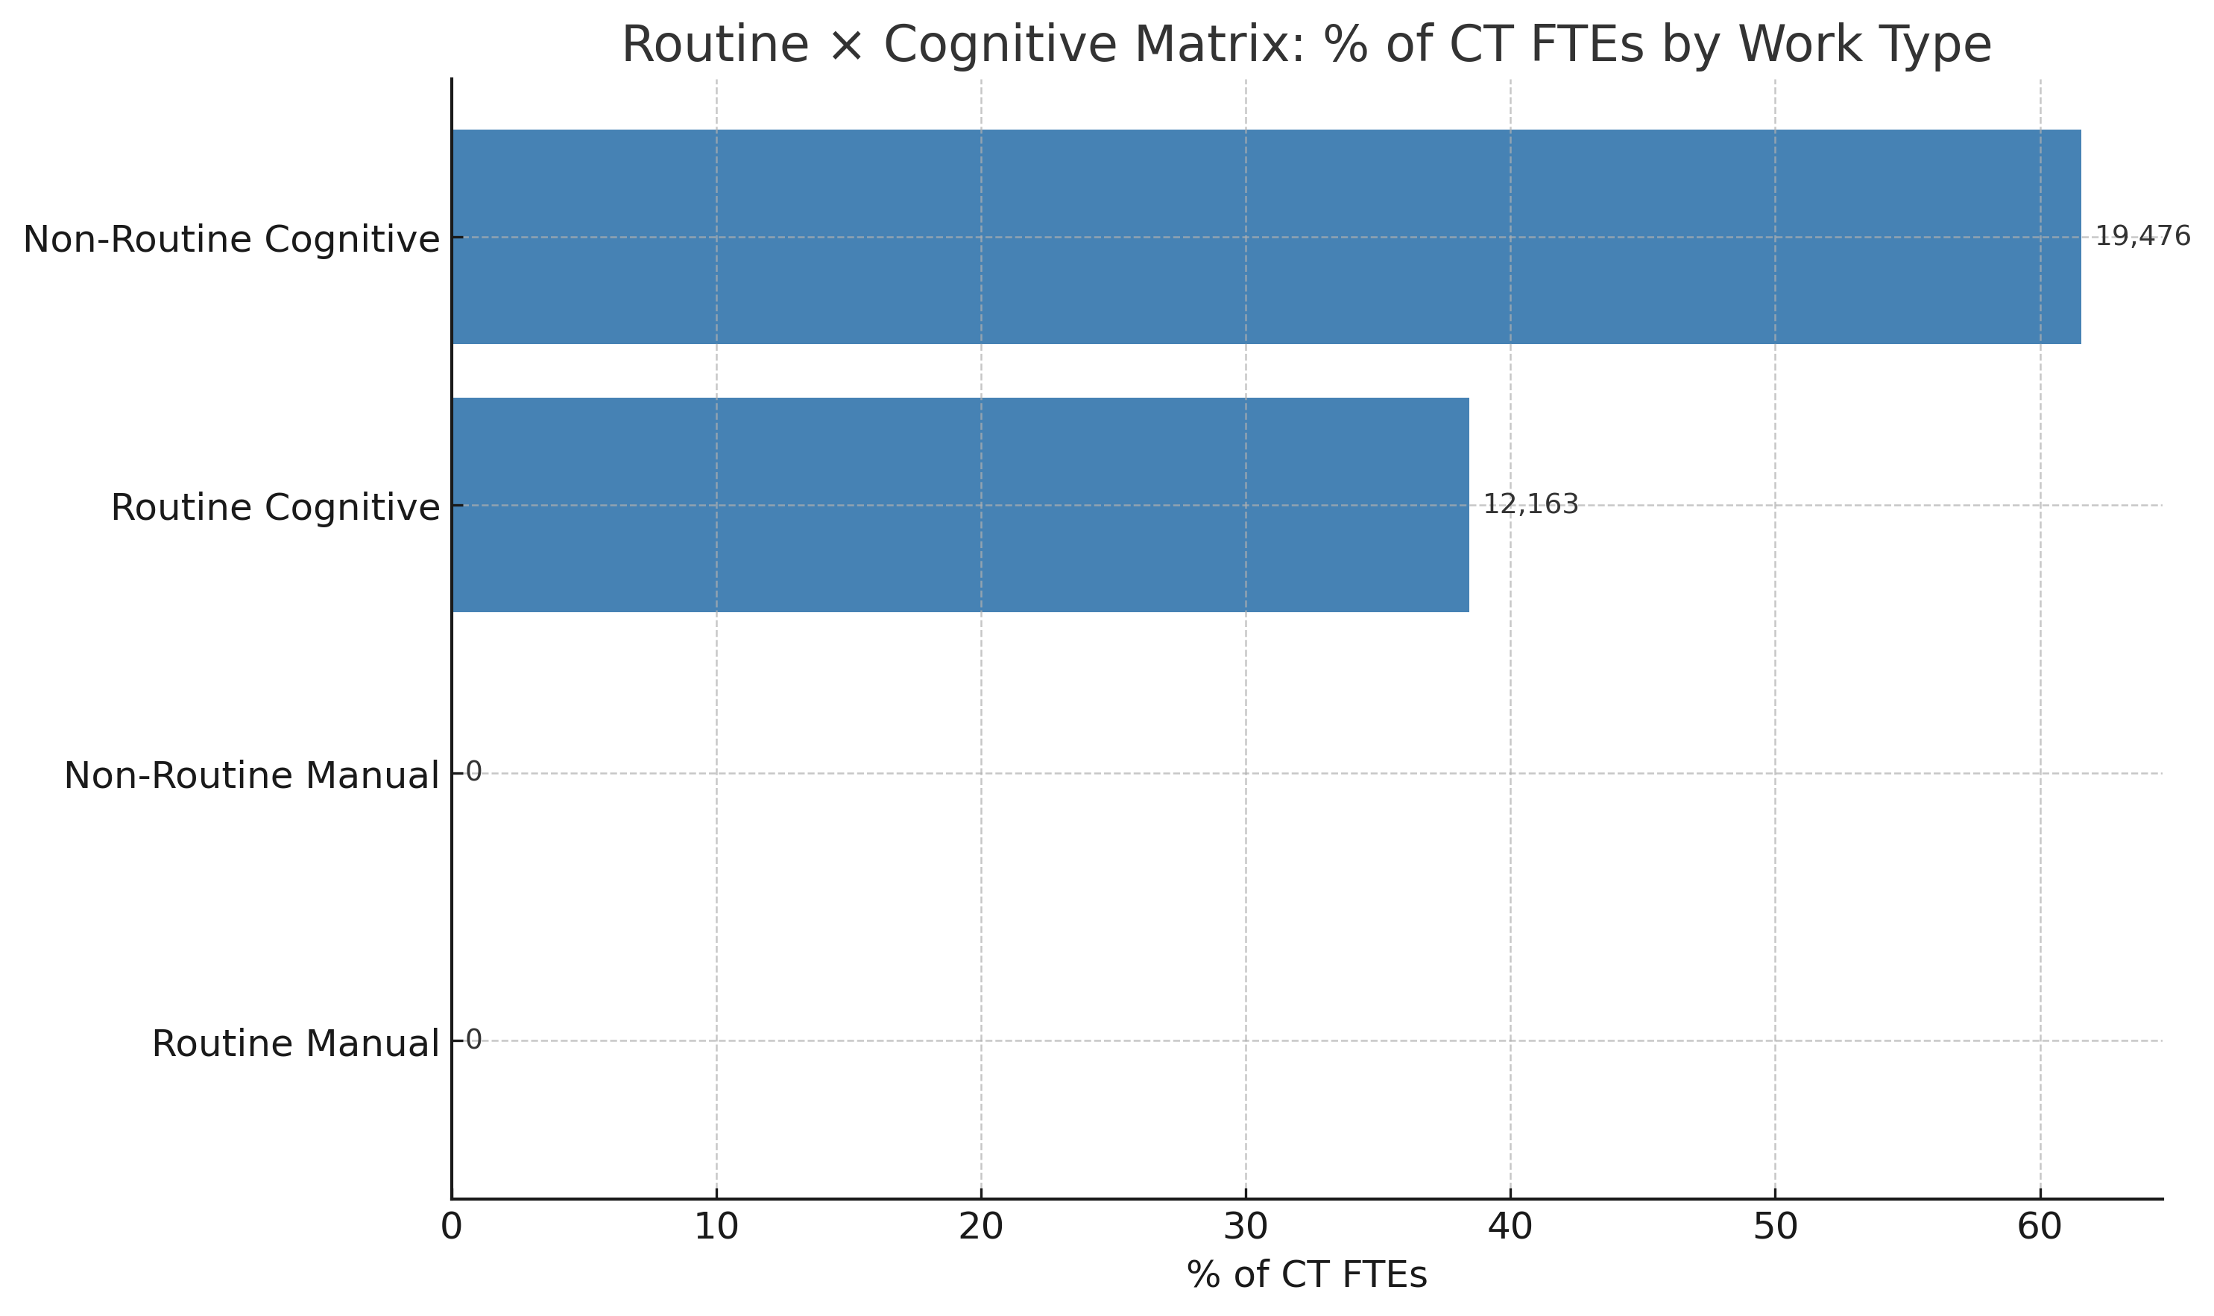
- Routine Cognitive: 67%
- Non-Routine Cognitive: 23%
- Routine Manual: 10%
- Non-Routine Manual: 0%

Slide 8
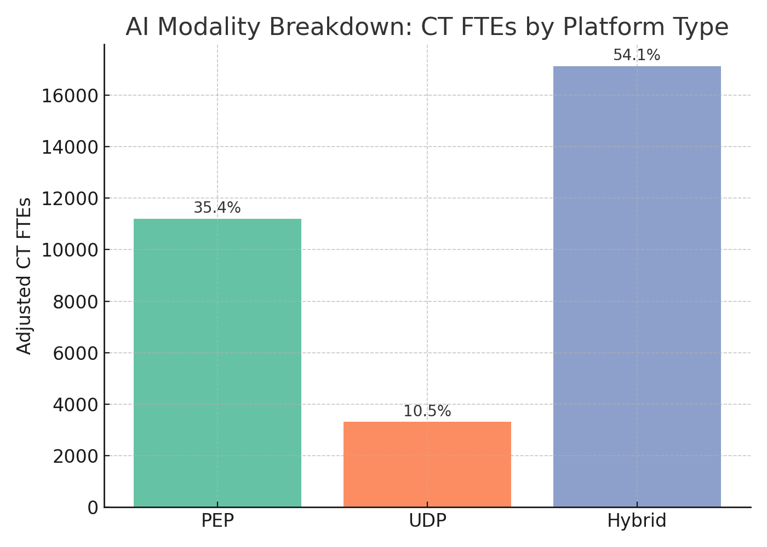
Chart 5 – AI Modality Breakdown

Slide 9
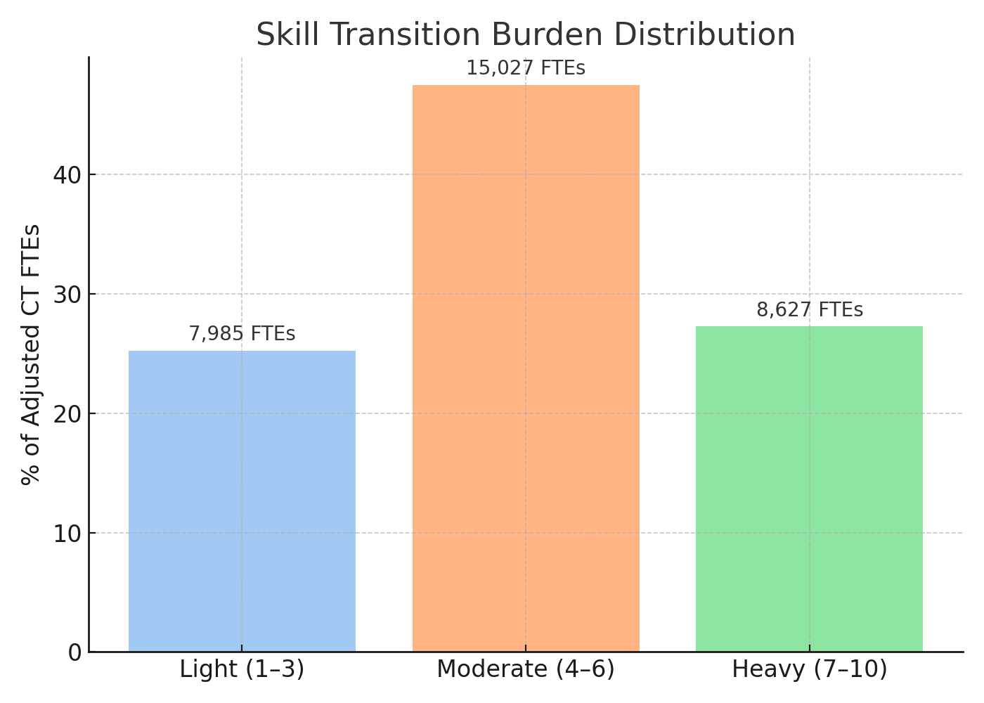
- Light (1–3): 51.1%
- Moderate (4–6): 30.2%
- Heavy (7–10): 18.7%

Slide 10
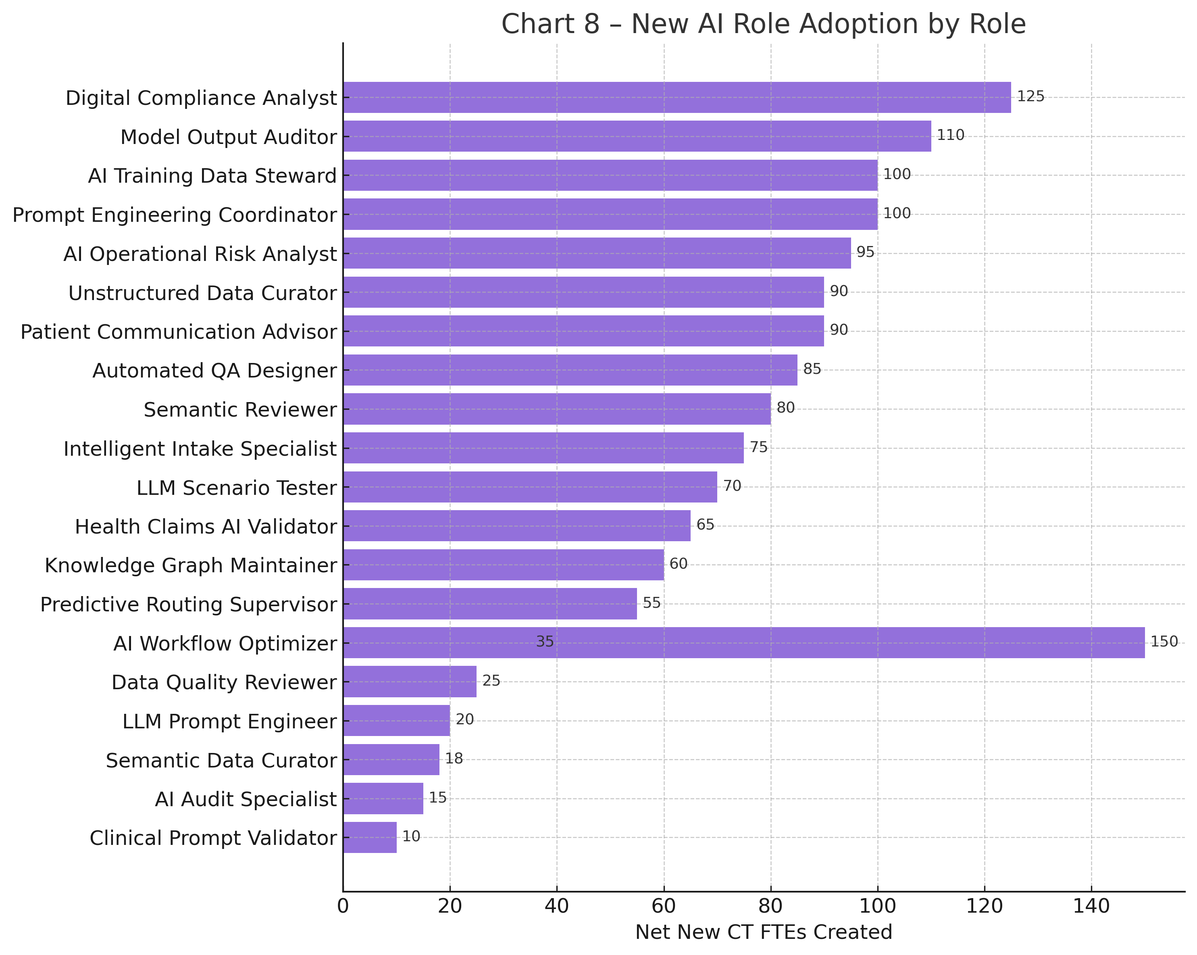
- Claims Risk AI Analyst
- AI-Enabled Appeals Coordinator
- NLP Compliance Auditor
- Patient Reimbursement Navigator
- Claims Risk AI Analyst
- AI-Enabled Appeals Coordinator
- NLP Compliance Auditor
- Patient Reimbursement Navigator

Slide 11
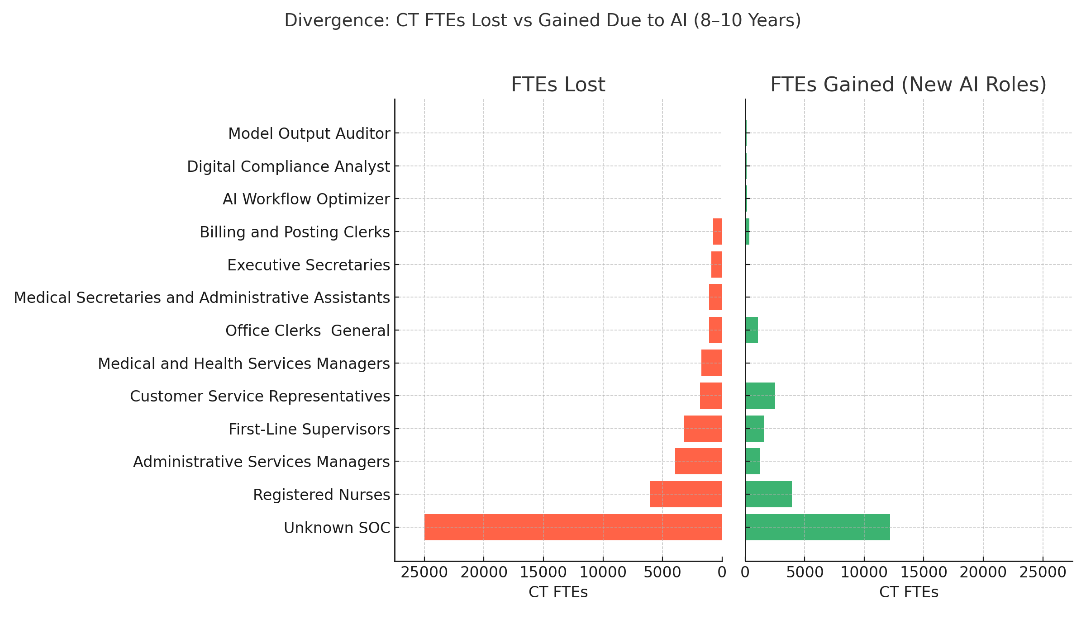
Chart 7 – Divergence: CT FTEs Lost vs Gained

Slide 12
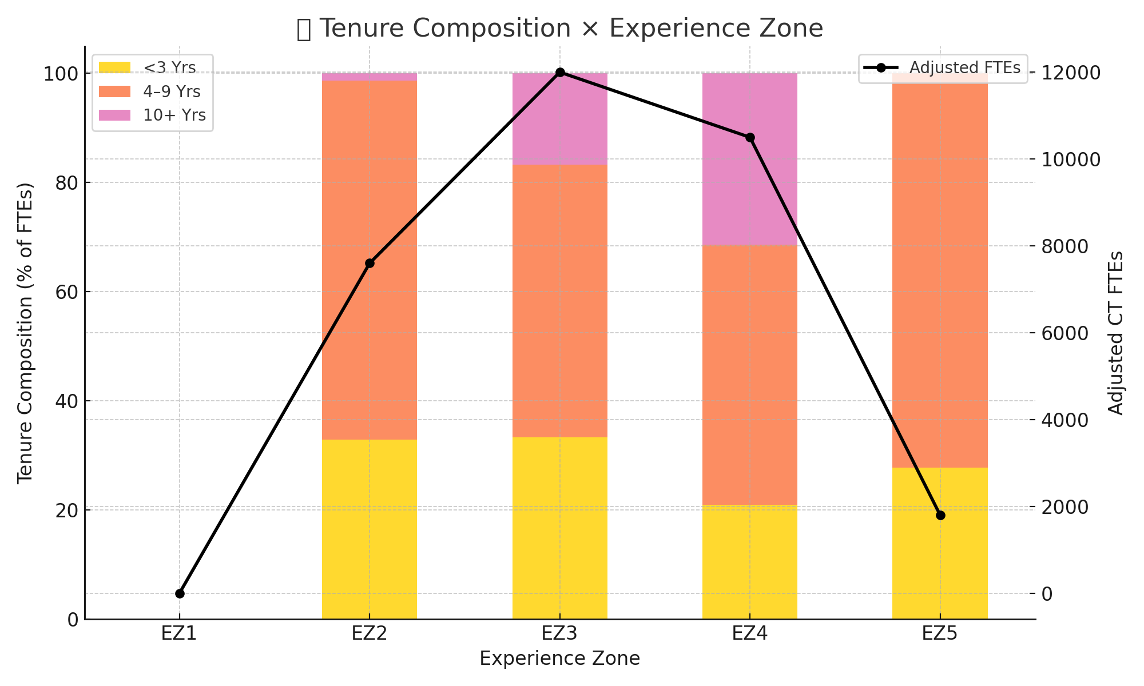
Chart 10 – Tenure Composition × Workflow

Slide 13
Appendix A
📏 **Scales & Classifications Used**
🔹 **AI Risk Bands (% Displacement Probability)**
- Very Low: 0–10%
- Low: 11–25%
- Moderate: 26–50%
- High: 51–75%
- Very High: 76–100%
🔹 **Skill Transition Burden (1–10)**
- Light: 1–3
- Moderate: 4–6
- Heavy: 7–10
🔹 **Tenure Bands**
- <3 years, 4–9 years, 10+ years
🔹 **Work Types**
- Routine vs Non-Routine
- Cognitive vs Manual
🔹 **Experience Zones (EZ1–EZ5)**
- EZ1: Little or no preparation
- EZ5: Extensive preparation (advanced degree + experience)

Slide 14
Appendix B
📚 **Data Sources & Role Mapping**
**Primary Source Frameworks**
- U.S. Bureau of Labor Statistics (BLS)
- O*NET Online: SOC Job Descriptions & Zones
- Connecticut Department of Labor (CT DOL)
- OPM GS-SOC Crosswalk (used for EZ)
- Assessment Rubric v10.4 (AI Risk, Burden, Augmentation)
- Modality Framework: *PEP vs UDP Capabilities.pptx*
**Workflow Mapping by Analyzer v4**
- Each task mapped to SOC × % time × % contribution × EZ × Tenure
- Analyzer outputs then aggregated for Comparor analysis

Slide 15
Appendix C
📖 **3rd-Party Research Referenced**
- *Jobs Lost, Jobs Gained* – McKinsey Global Institute (2017, 2023 updates)
- *Routine Task Intensity & Job Risk* – Federal Reserve Bank of St. Louis
- *ALM Framework* – Autor, Levy, Murnane (2003–2015)
- *Experience Zones Model* – David Dorn (EZ1–EZ5) occupational ladder
- *AI & Workflow Role Study* – ChatGPT v4 Analyzer Methodology (custom for CT project)

